Slide 1
Big data analysis with IBM Cloud database
IBM Cloud offers a range of services for big data analysis, providing innovative solutions to handle large volumes of data efficiently. With IBM Cloud databases, several innovative features enhance big data analysis:

Slide 2
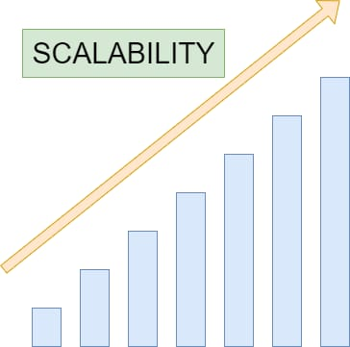
Scalability:
IBM Cloud databases can scale horizontally and vertically, allowing businesses to handle growing volumes of data without compromising performance. This scalability ensures that as data grows, the system can handle the load effectively.

Slide 3
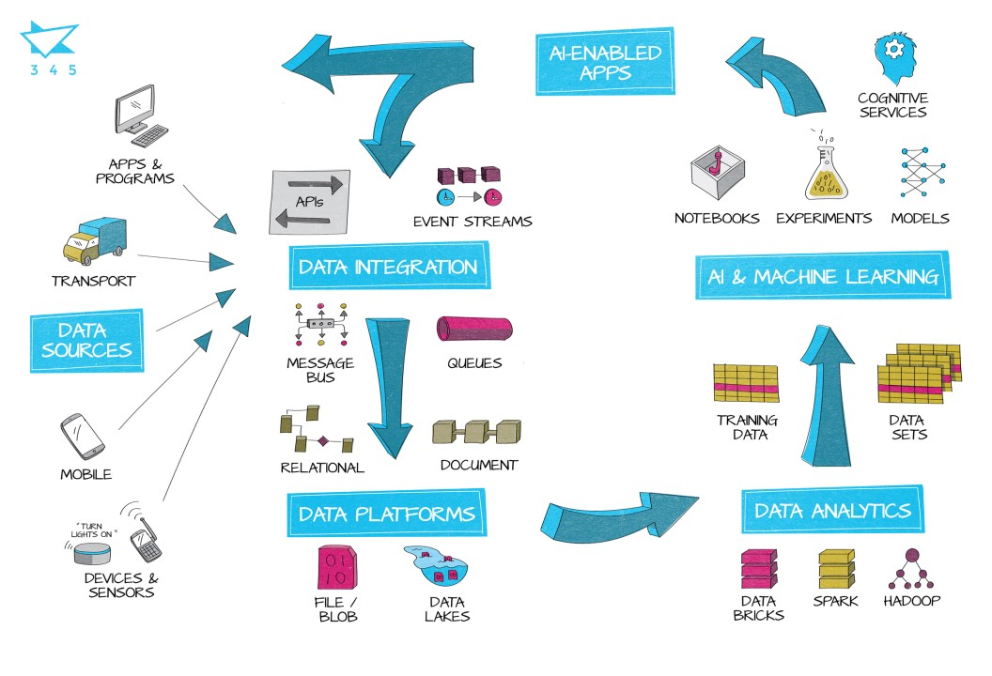
Integration with AI and Machine Learning:
IBM Cloud services integrate seamlessly with AI and machine learning tools. This integration enables businesses to derive valuable insights from their data, predicting trends, customer behavior, and optimizing processes.

Slide 4
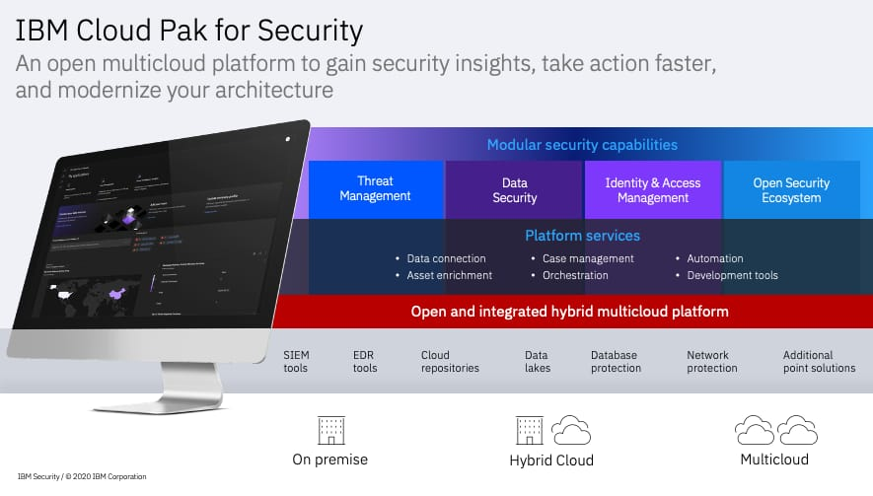
Security:
IBM Cloud emphasizes robust security protocols, ensuring that sensitive data is protected. This is crucial for businesses dealing with large datasets containing valuable or private information.

Slide 5
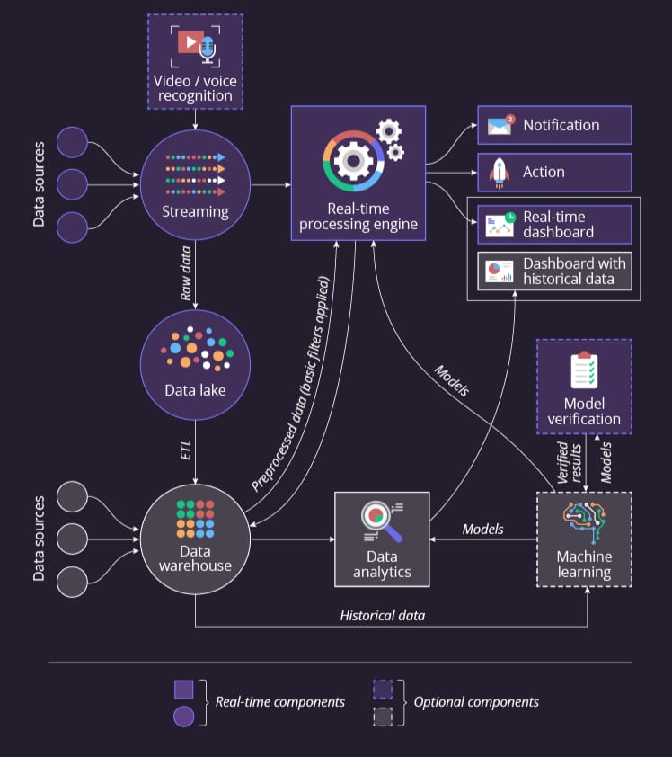
Real-time Analytics:
IBM Cloud databases support real-time data analytics, allowing businesses to make decisions based on the most current information available. Real-time analytics are invaluable for industries such as finance, where split-second decisions can have a significant impact.

Slide 6
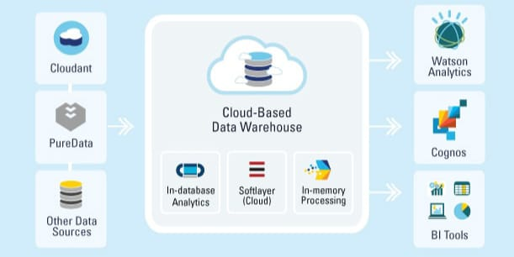
Data Warehousing:
IBM Cloud provides data warehousing solutions that enable organizations to store and manage large volumes of structured and unstructured data. This data warehousing capability is essential for big data analysis, allowing businesses to store diverse data types in a single, easily accessible repository.

Slide 7
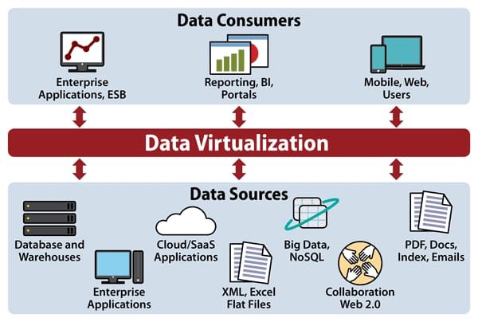
Data Visualization:
IBM Cloud offers tools for data visualization, allowing businesses to create interactive and meaningful visual representations of their data. Visualization simplifies complex datasets, making it easier for stakeholders to understand the insights derived from big data analysis.

Slide 8
Cost-effectiveness:
IBM Cloud databases are designed to be cost-effective, allowing businesses to pay for the resources they use. This scalability ensures that organizations do not overspend on resources they do not need, making big data analysis financially feasible for businesses of all sizes.
By leveraging these innovative features, businesses can harness the power of IBM Cloud databases for effective and insightful big data analysis, driving informed decision-making and competitive advantage

Slide 9
Code:
<!DOCTYPE html>
<html lang="en">
<head>
<meta charset="UTF-8">
<meta name="viewport" content="width=device width, initial-scale=1.0">
<title>Big Data Analysis</title>
</head>
<body>
<h1>Big Data Analysis with IBM Cloud Database</h1>
<form id="analysisForm">
<label for="dataParameter">Enter Data Parameter:
</label>
<input type="text" id="dataParameter“
name="dataParameter" required><br><br>
<label for="analysisType">Select Analysis Type:</label>
<select id="analysisType" name="analysisType“
required>

Slide 10
<option value="1">Analysis Type 1</option>
<option value="2">Analysis Type 2</option>
<!-- Add more analysis types as needed -->
</select><br><br>
<button type="submit">Submit</button>
</form>
<div id="result"></div>
<script> document.getElementById("analysisForm").addEventListener("submit", function(event) {
event.preventDefault();
const formData = new FormData(this);
document.getElementById("result").innerText = "Performing analysis...";
});
</script>
</body>
</html>

